Slide 1
Welcome to
Rose Building Services
www.rosebuildingservices.com
Tel 01403 733362

Slide 2
Content
Rose Building Services (RBS)
Our Experience
Services we provide
Examples of Projects Undertaken
CV’s of Directors

Slide 3
Rose Building Services
Rose Building Services (RBS) is a leading Design, Technical Services & Commissioning Management company operating across London, the Home Counties and the South of England.
Founded in 1998 we are a well established company, our team has a wealth of experience in M&E Technical and Commissioning management across the majority if not all construction sectors. We pride ourselves on customer satisfaction, providing a quality service whilst ensuring value for money.
We are the preferred choice for many leading blue chip companies, and we have been involved with a number of prestigious projects such as Houses of Parliament, Tottenham FC Stadium, Twickenham Stadium, The Savoy Hotel, Fortnum and Mason, Gatwick Airport, University of West London Campus & Royal Holloway University, to name a few.

Slide 4
Our Experience
In order to have an holistic assessment of a buildings M&E systems the appointment of an independent team consisting of Technical Services Managers and Commissioning Managers is vital.
All our senior managers have between 25 – 30 years experience in the MEP industry and their backgrounds range from main contractors, sub contractors, consultancy and key suppliers such as Building Management Systems.
Our team of senior management have experience from all over the world in sectors ranging from Commercial, Data Centre’s, Health Care, Laboratories, Residential and Retail.
Our ethos is founded on sound & reliable service meaning on time delivery.

Slide 5
Services we provide
Tender Analysis
Pre- Construction Management
Technical Services Management
Commissioning Management

Slide 6
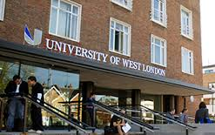
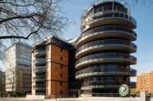
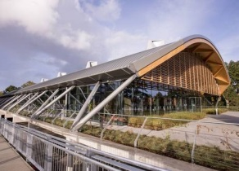
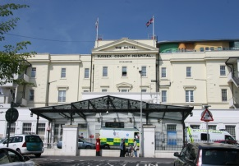
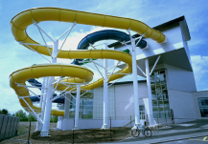
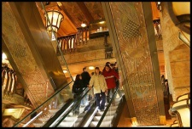
Examples of Projects Undertaken
Education
PROJECT: | University of West London
VALUE: | £48M
CLIENT: | University of West London
Residential
PROJECT: | The Atrium, St Johns Wood, London
VALUE: | £27M
CLIENT: | Pantelli Associates
Commercial
PROJECT: | WWF Head Office, Wokingham
VALUE: | £14M
CLIENT: | World Wildlife Fund.
Health care
PROJECT: | Brighton & Sussex University Hospital
VALUE: | £35M
CLIENT: | Brighton NHS trust
Leisure
PROJECT: | Basingstoke Leisure Centre
VALUE: | £15M
CLIENT: | Alliance Leisure
Retail
PROJECT: | Harrods Egyptian Staircase, Knightsbridge
VALUE: | £21M
CLIENT: | Harrods

Slide 7
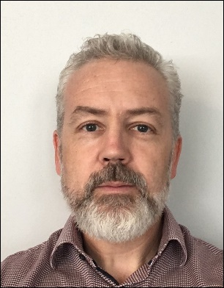
CV’s
John Saunderson - Director
Steve Sayles – Operations Director

Slide 8
John Saunderson
Director
Along with Dave Rose, July 1998 saw the formation of Rose Building Services and have seen it develop into a strong, reliable and trust worthy company.
John’s expertise has been developed over the past 25 years based within the mechanical and electrical industry. John has worked on both the Contracting and Consultancy side of the business and has gained a wealth of experience from all types of building projects in all sectors of the industry.
In the past John has been responsible for many high profile projects, taking full control of the Building Services for the design, co-ordination and installation of the Building Services.
Aberfeldy
RAF Club, Mayfair
G-live, Guildford
The Waterside Theatre, Aylesbury
Royal Holloway University of London, Lecture Theatre
Royal College of Obstetricians & Gynaecologists
John is a highly self-motivated team player with energy and enthusiasm to succeed. He relishes challenges and offers solid solutions in a hands-on capacity when required, delivering high quality work.
.

